Slide 1

A
Presentation
On
Book Store Management System
Presented by:
1.Jambhale Dipali(EBEON0522602992)
2.Vaidya Pratiksha(EBEON0522601614)
3.Tupake Pallavi(EBEON0522601621)
4.Nehe Shreya(EBTSOC0522598195)
5.Arakhade Prajakta(EBEON0522601543)
Guided by:
Mehta Pooja mam
Java Full Stack Developer
2022-7469

Slide 2
Contents
Introduction
Required Specification
Proposed System
Spring Annotation
Usecase Diagram
Class Diagram
ER Diagram
Screenshots
Advantages

Slide 3



Slide 4
Introduction
Book Store Management System is designed to make the everyday working of the book store very easy and simple.
It can be done wherever we are by just using the application.
It keeps track of add the book , update the books , insert the new books, delete the book in the book store.
It helps to provide all the information to the user .

Slide 5
Required Specification
Hardware Configuration | Software Configuration
Operating System : Windows 10,11 | Software IDE : Spring Boot
Hard Disk : 1TB | Language : Java
RAM : 8GB | Back End : MySQL Server , Postman

Slide 6
Proposed System
This system is a bunch of benefits from various point of view. As this book store management system enables the add different books in the book store ,update the books, delete the book , insert the new books in the book store.
System will store the information about the books records.it will keep the records of each and every sold books and many more data.

Slide 7
Spring Annotations
@Autowired: The @Autowired annotation provide more fine grained control over where and how autowiring should be accomplished.
@RequestMapping : The @RequestMapping is one of the most common annotation used in spring web application. This annotation maps HTTP requests to handler method of MVC and REST controllers.
@PathVariable : The @PathVariable Spring annotation on a method argument to bind it to the value of a URI Template variable.
@RequestParam : The bind Request Parameter to method variable using spring annotation @RequestParam .

Slide 8
Spring Annotations
@Configuration : Used to indicate that a class declares one or more @Bean methods . These classes are processed by the spring container to generate bean definition and service requests for those bean at runtime.
@Bean : indicates that a method produces a bean to be managed by the spring container.
@Controller : the @Controller annotation is used to indicate the class is a spring controller. This annotation can be used to identify controllers for spring MVC or Spring WebFlux .

Slide 9
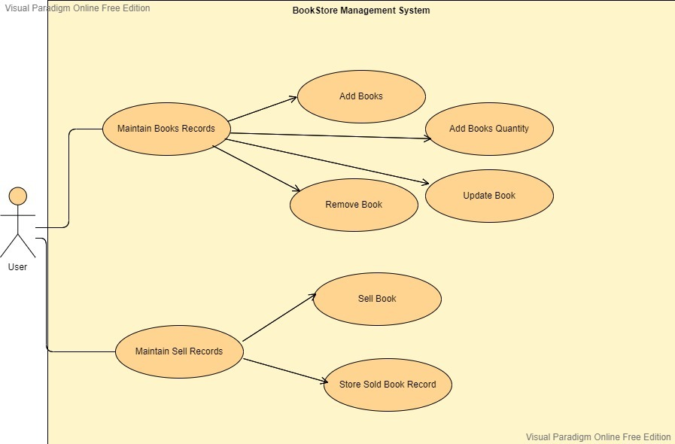
Usecase Diagram

Slide 10
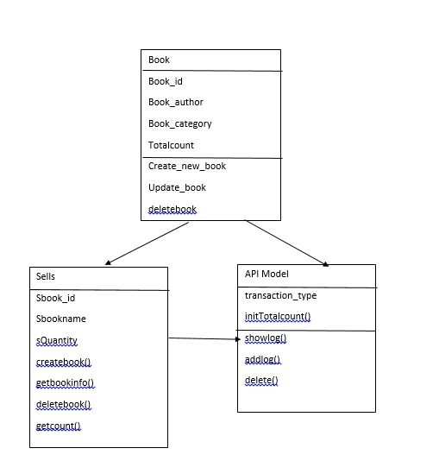
Class Diagram

Slide 11
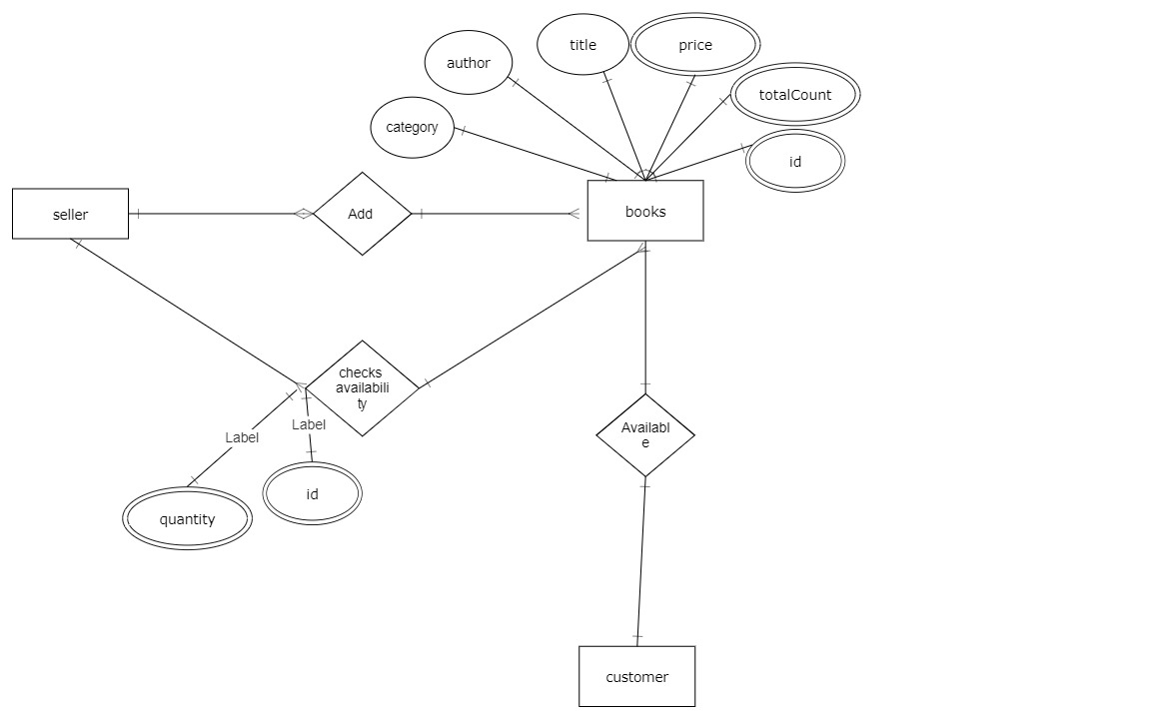
ER Diagram

Slide 12
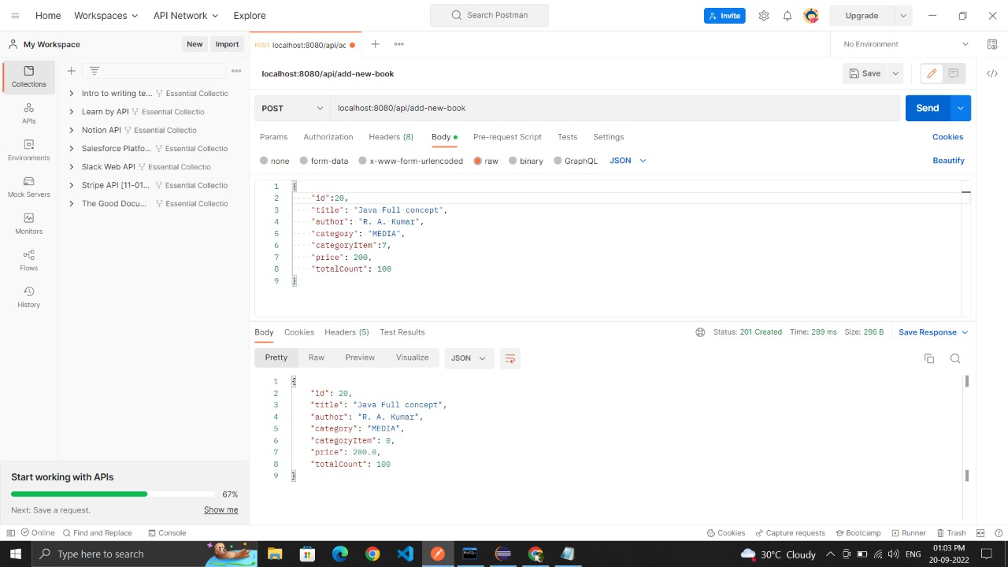
Screenshots:
1] POST:
Add New Books

Slide 13
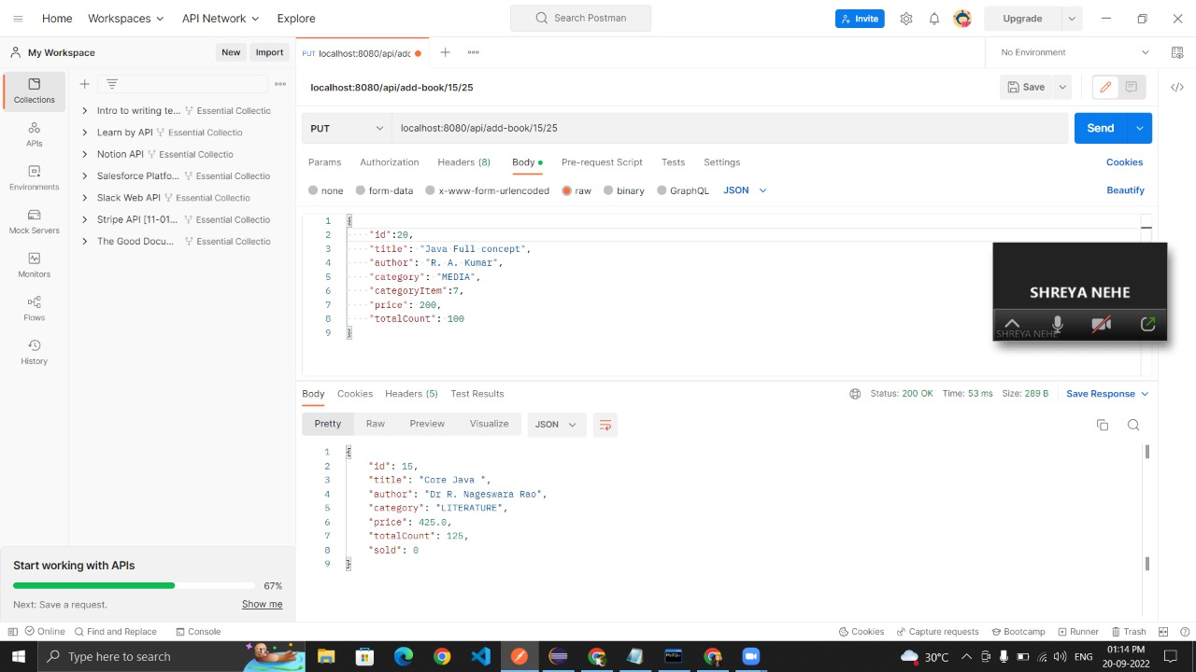
2] PUT :
Add quantity of book to the existing book.

Slide 14
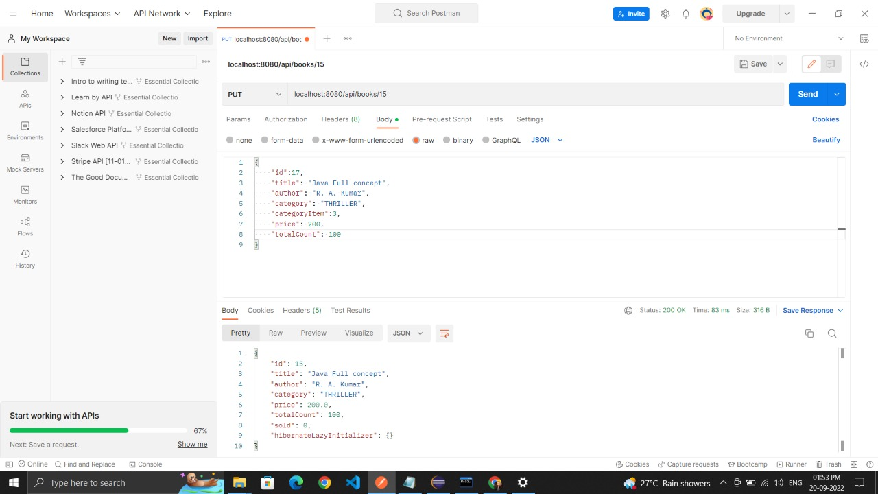
2] PUT :
Update a book.

Slide 15
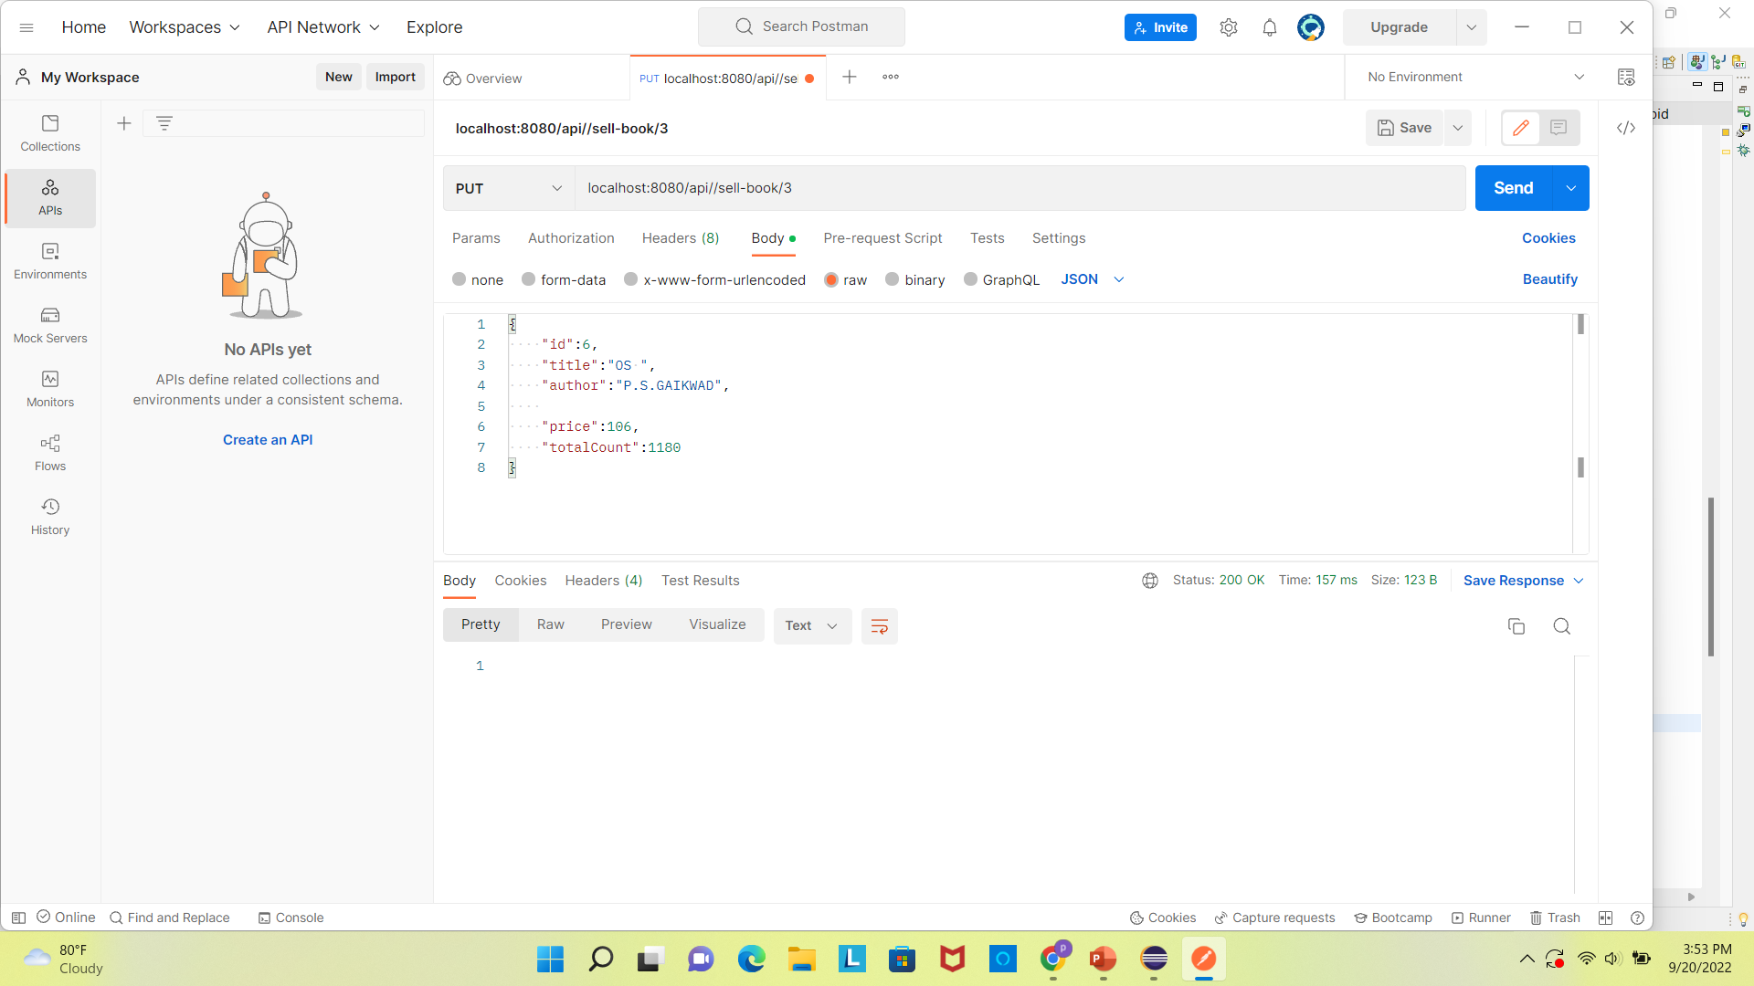
2]PUT
Sell a single book

Slide 16
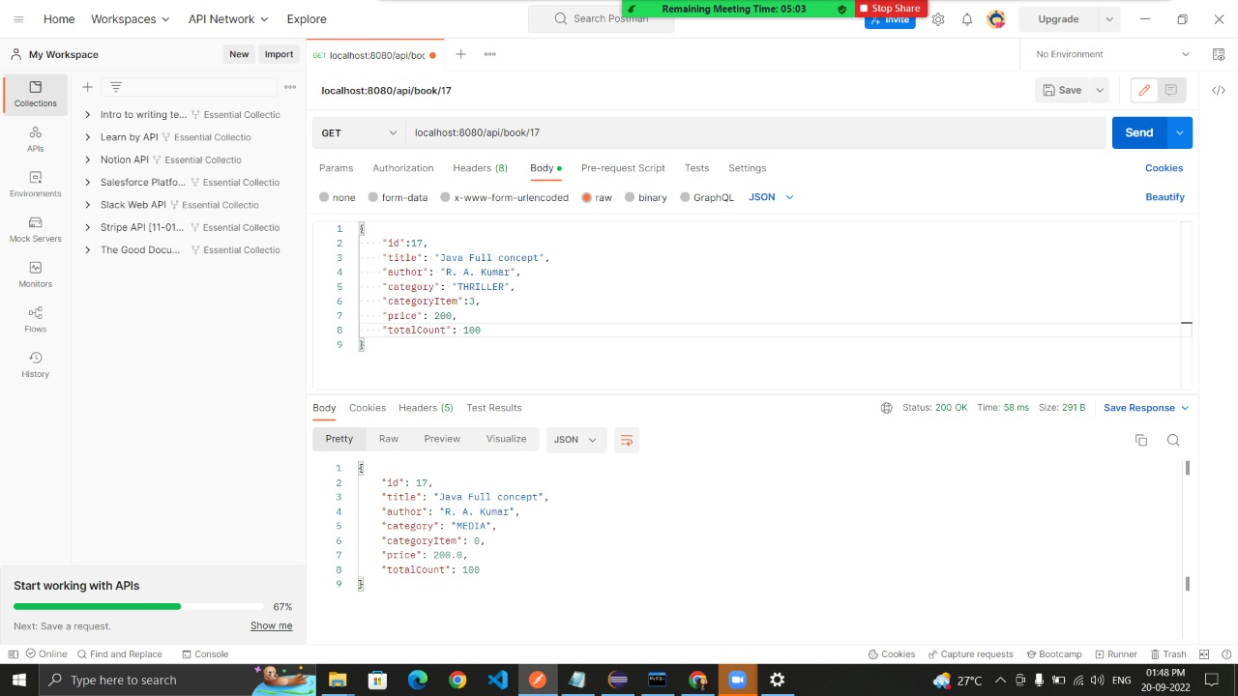
3] GET:
Get books by id

Slide 17
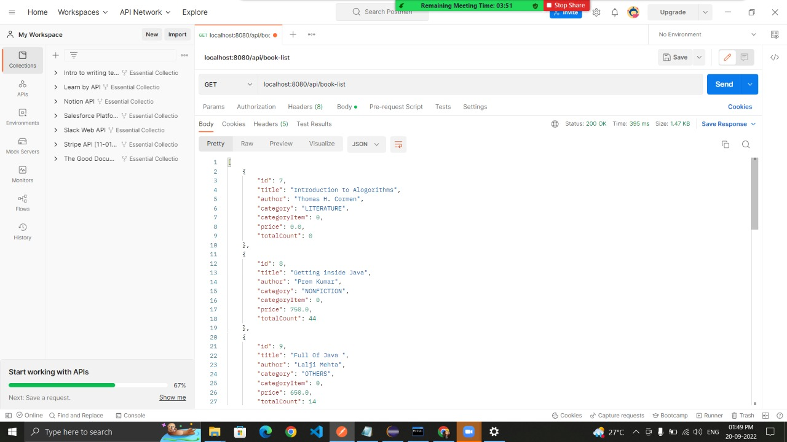
3] GET
Get All Books

Slide 18
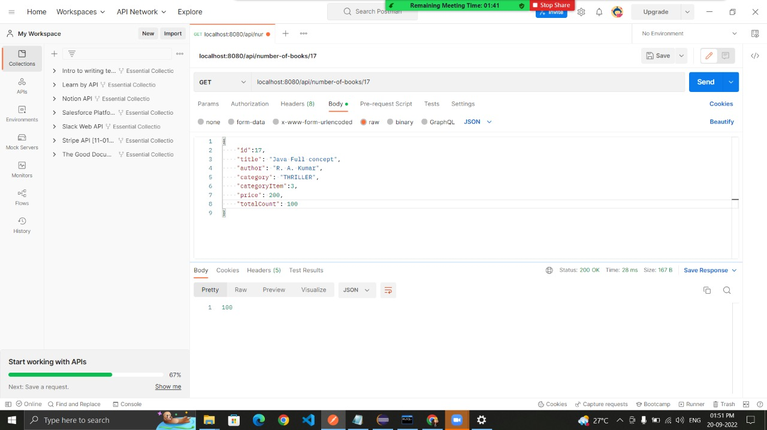
3] GET :
Get number of books available by id.

Slide 19
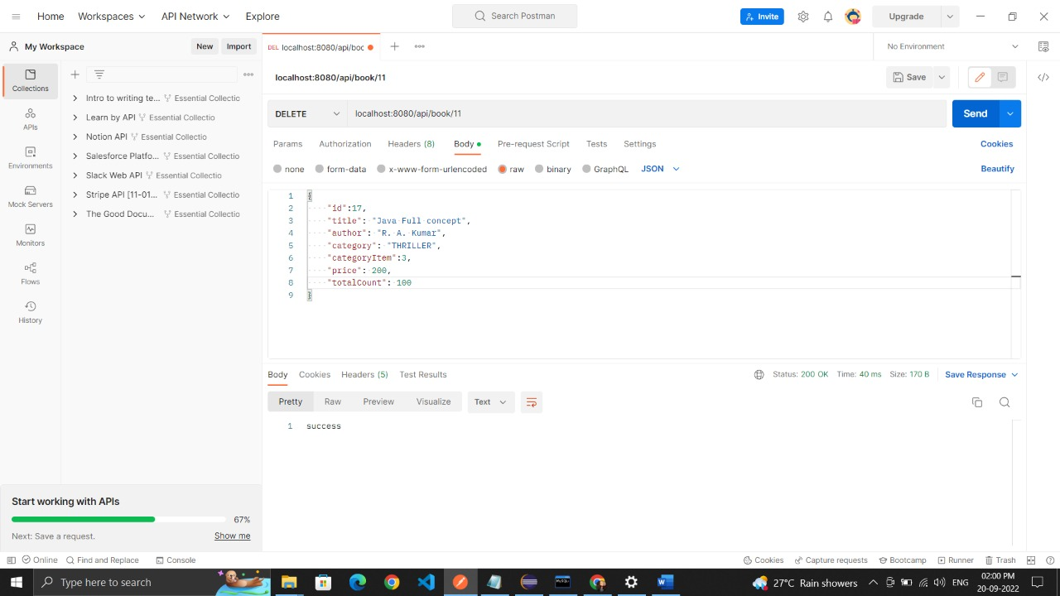
4] DELETE :
Delete the record by using id.

Slide 20
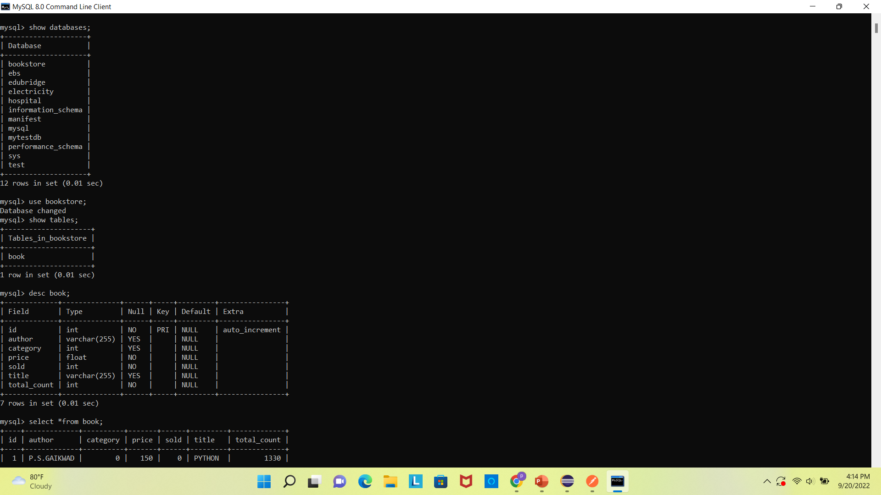

Slide 21
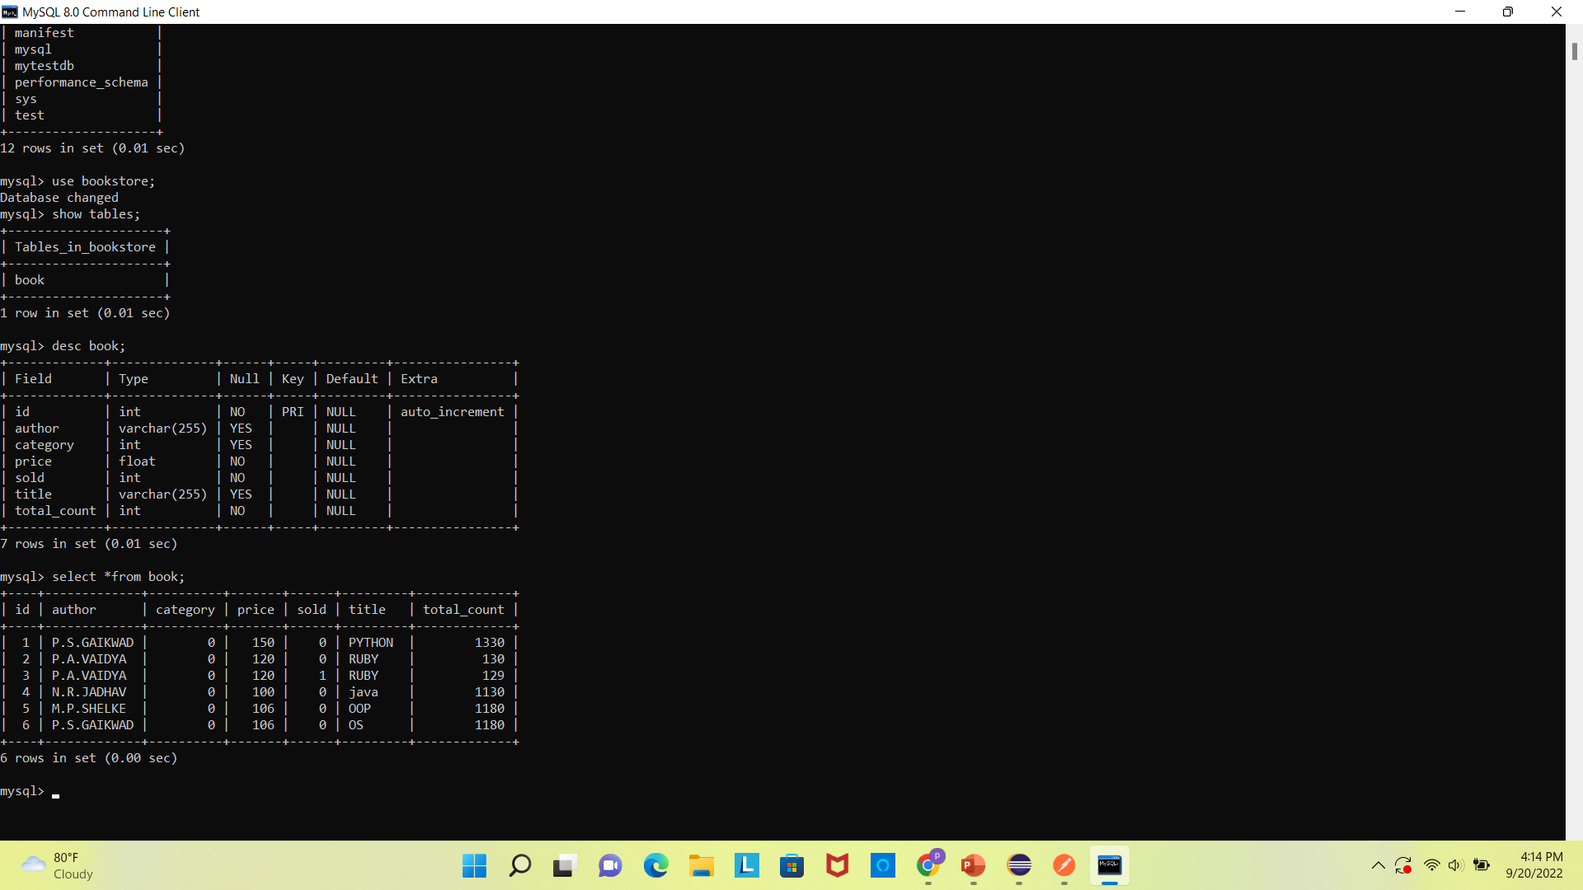

Slide 22
Advantages
It is User-friendly System.
It keeps tracks of all the books.
It gives us all the information about the books.
It focuses on day to day operations in book store such as the user search book by using id.
It increases efficiency in managing the books .

Slide 23
Thank You…

